Slide 1
Software Project Lab-1
Name: Saimon Bhuiyan
Bsse Roll: 1402

Slide 2

Programmer De-Anonymizer
De anonymize a programmer using static code analysis.
Supervised By
Dr. Kazi Muheymin-Us-Sakib
Professor
IIT,University of Dhaka

Slide 3

Table of contents
Project Description
Motivation
Working Methodology
Progress
Future Plan
Technology
Challenges
References

Slide 4
Project Description

Slide 5
“Programmer De-Anonymizer” will identify anonymous programmer based on their coding style using static code analysis. The project will provide a similarity score indicating how closely a programmer’s coding style aligns with a specific style icon. Basically we divide all the programmer in different cluster with that similarity score.

Slide 6
Motivation

Slide 7
Programmer De-Anonymizer will be helpful in a forensic context such as detection of ghostwriting, a form of plagiarism in computer science, detection of code copy among students.

Slide 8
Working Methodology

Slide 9
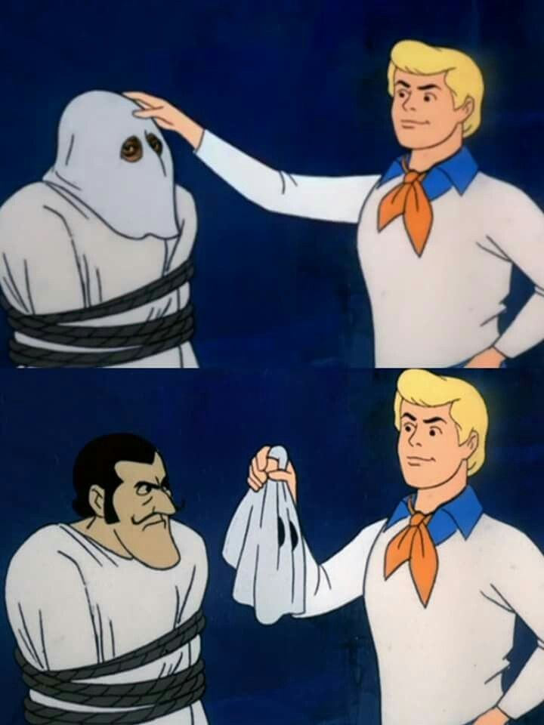
Our work in one slide
*anonymous programmer
Programmer
De-Anonymizer
*Saimon
Programmer
De-Anonymizer
But How?

Slide 10
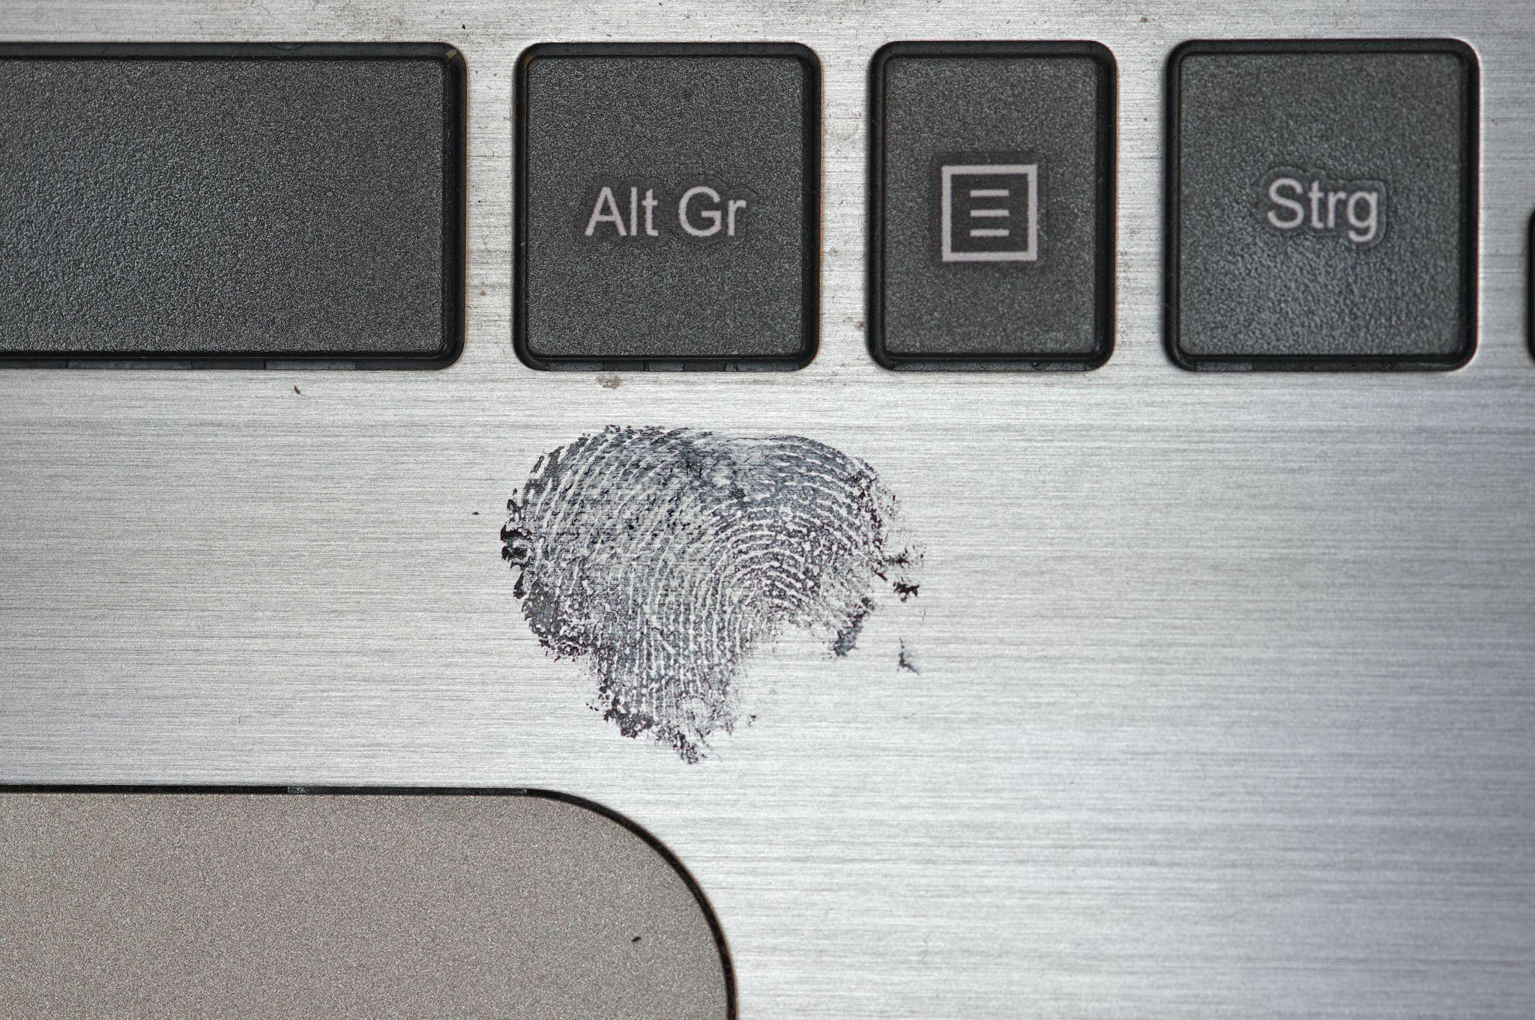
Fingerprint
Style is preserved.
A Caliskan, George Washington University
Rachel Greenstadt and Aylin Caliskan have found that code, like other forms of stylistic expression are not anonymous.

Slide 11
Project Flow

Slide 12
Collected Data
Some known programmer.
A constant number of c file from each programmer.

Slide 13
Types of Features
Lexical Features
Layout Features
Syntactical Features
Variable naming,identifier, commenting pattern.
Indentation,brace placement,whitespace around operator.
Function declaration and definition,use of data structure.

Slide 14
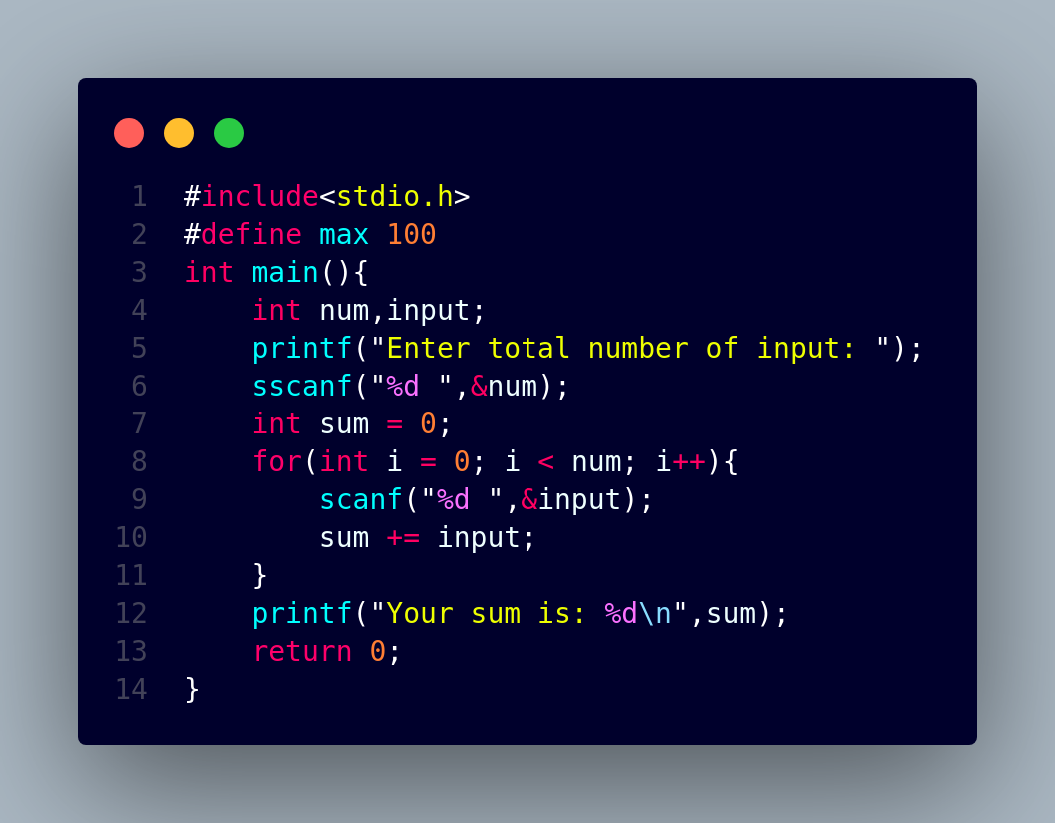
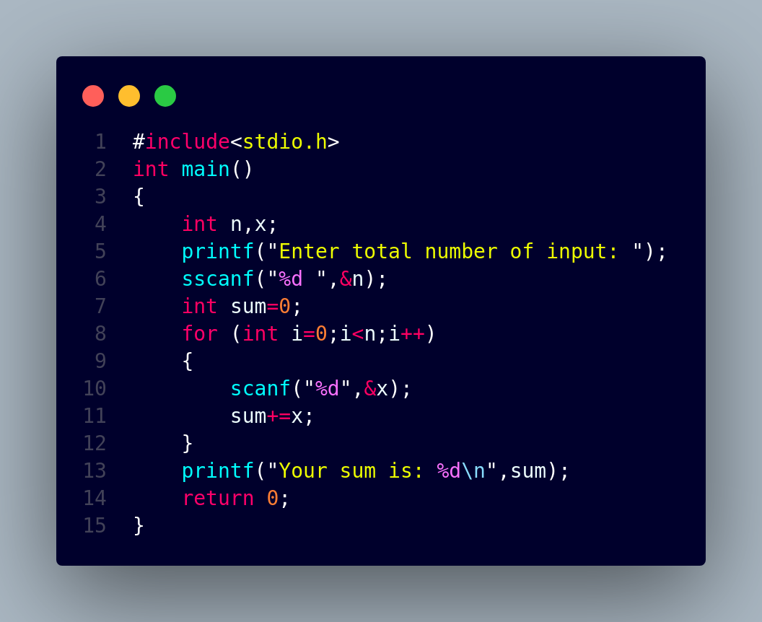
Sample - 2
Sample - 1

Slide 15
Collect Data
Tokenize Data
Create Control Flow and Data Graph
Extract Lexical and Layout Feature
Extract Syntactic Feature
Set of Feature

Slide 16



Input
Output
Stored
C File
Feature
Extractor
Feature Set

Slide 17
Set of Feature
Build Some Centrality Vector
Input File
Statistical Analysis
Build some 2D vector
Converted Image Vector
De-Anonymize Programmer
Clustering Different Programmer

Slide 18


Analysis
Saimon
Result
Input
Saimon
Saimon
Feature
Set
Statistical Analyzer
Most Likely
Programmer

Slide 19
Statistical Approaches
Empirical Rule
Z-score
Outlier Detection
Cosine Similarity

Slide 20
Progress

Slide 21
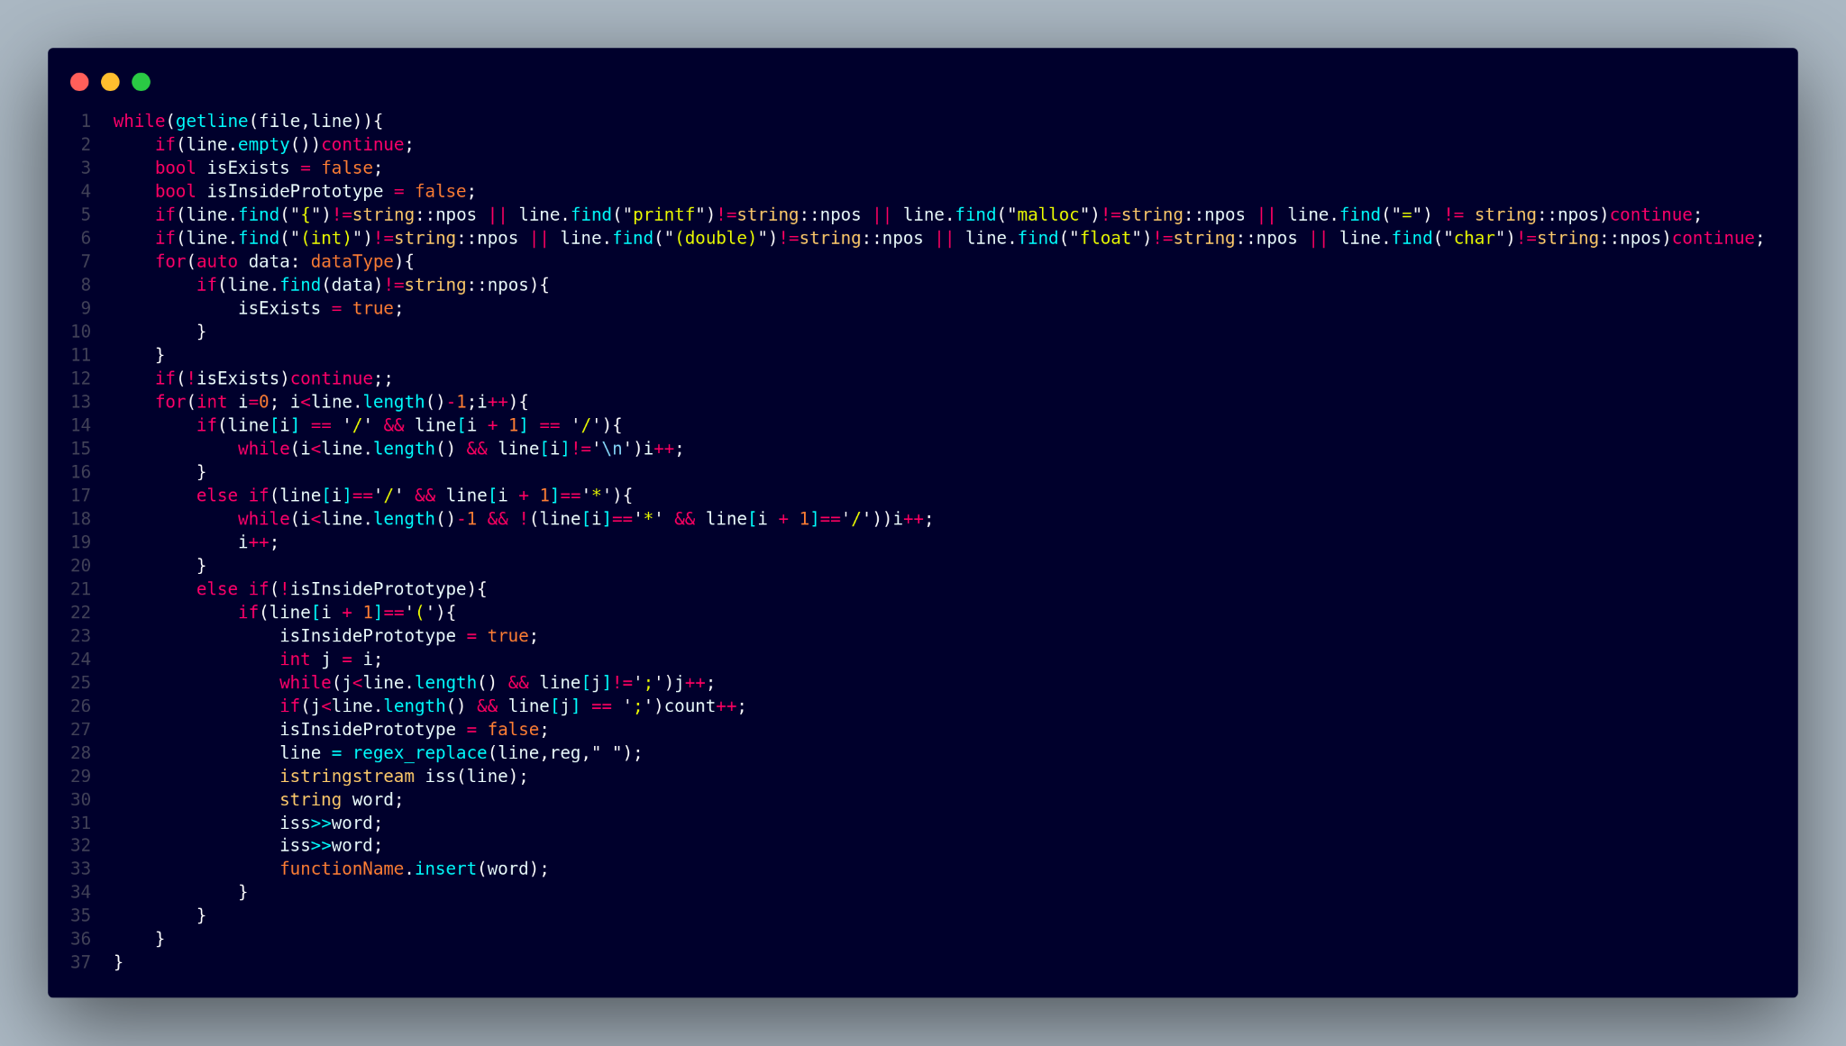
Extracting Function Prototype Feature

Slide 22
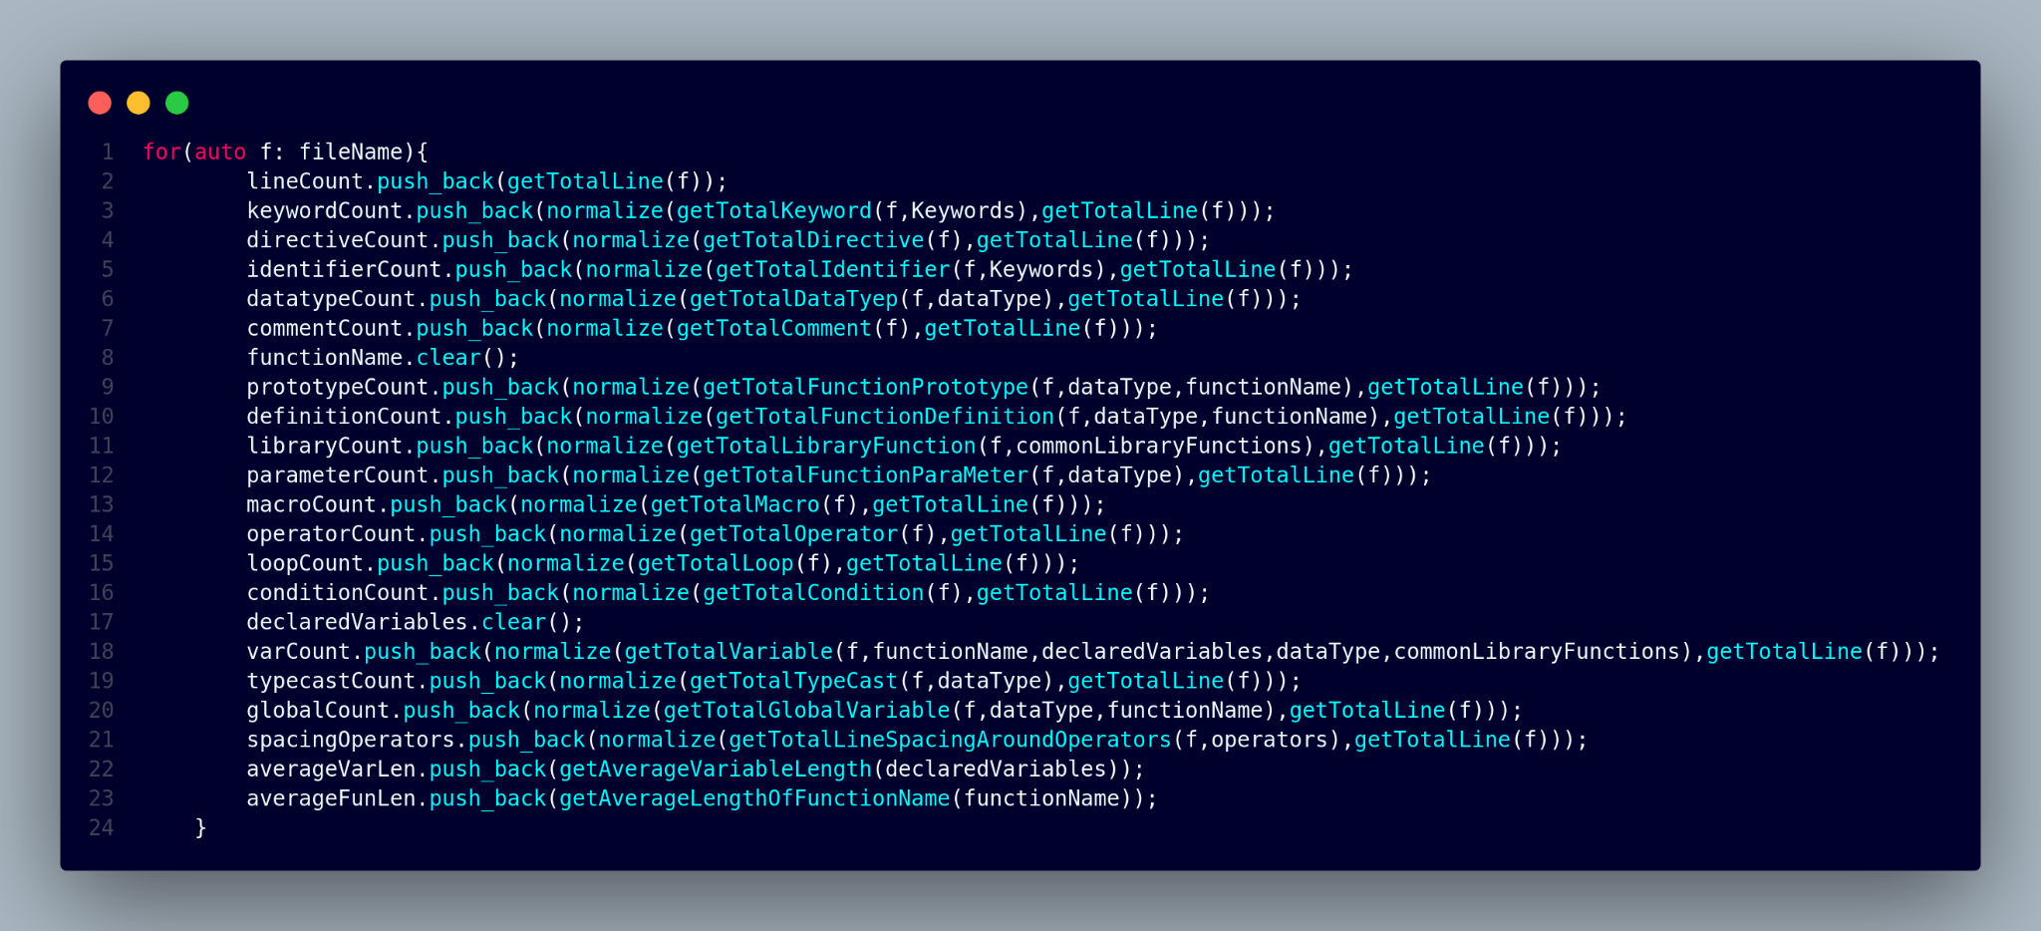
Extracting various feature for all the file from a directory

Slide 23
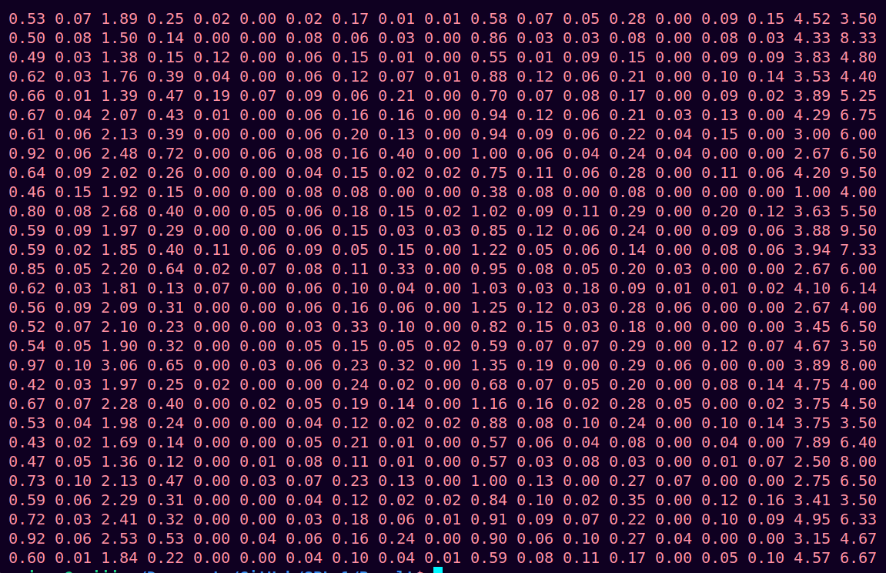
Extracted 2D feature vector after normalization.

Slide 24
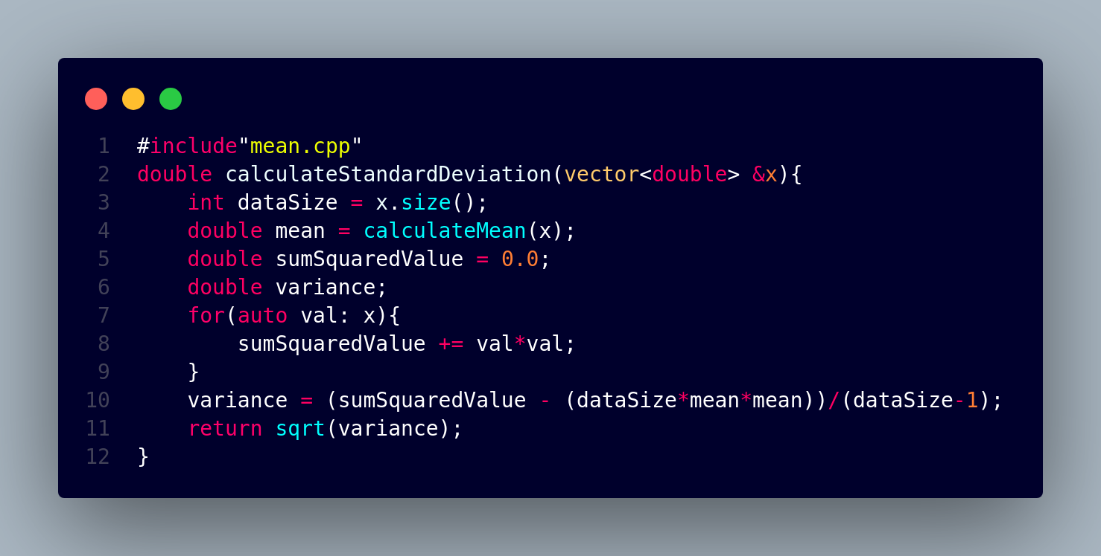
Calculating Statistical Value

Slide 25
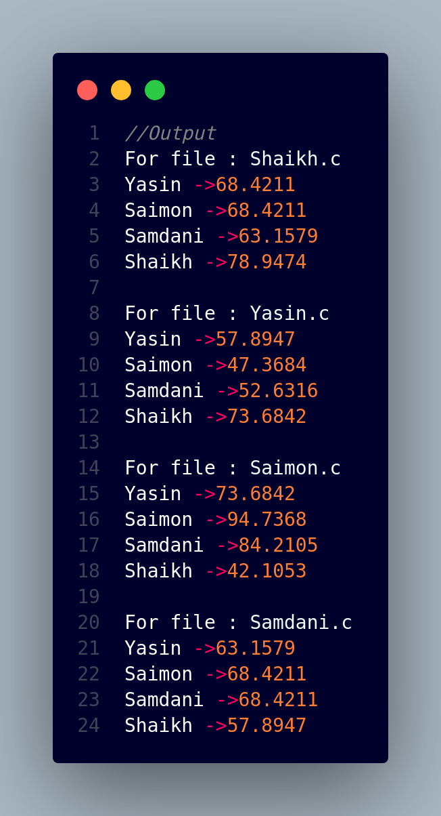
A sample output using Empirical rule. This analysis giving correct result quite accurately.

Slide 26
Future Plan

Slide 27
Upgrade the accuracy of analysis.
Create Control flow and Data graph to extract more syntactical features.
Combined them with existing features and create a feature set for statistical analysis.

Slide 28
Clustering different programmer according to their coding style.
Show the cluster member and probable programmer using statistical results.

Slide 29
Technology

Slide 30
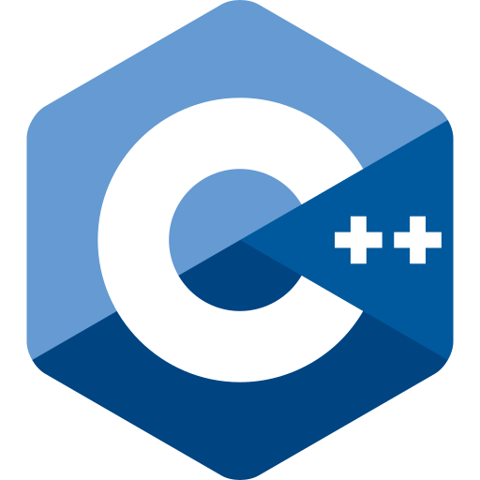


Slide 31
Challenges

Slide 32
Challenges so far:
First time working on a big project.
Preprocessing and manipulating the stored c file.
Choosing the feature and extracting them from a source code.
Read different directory to access c file and stored their extracted feature into a single space.
Further Challenges:
Find some statistical method which will give more accurate and reliable result in our context.
Learn about CFG and Data Graph and implement them.
Learn about clustering.

Slide 33
References
Article about Fingerprint
Source of Images
Sources of Icons
Project Link

Slide 34

Question & Answering

Slide 35


